Slide 1

Summer Training Report
W3grads(Flames’ 25)
Full Stack (MERN) with Gen AI
Submitted in partial fulfillment of the requirements for the award of degree of
B-Tech CSE Data Science and ML
Submitted to
LOVELY PROFESSIONAL UNIVERSITY PHAGWARA, PUNJAB
From 10/06/2025 to 30/07/2025 SUBMITTED BY
Name of student: Mithlesh Kumar Registration Number: 12325796

Slide 2
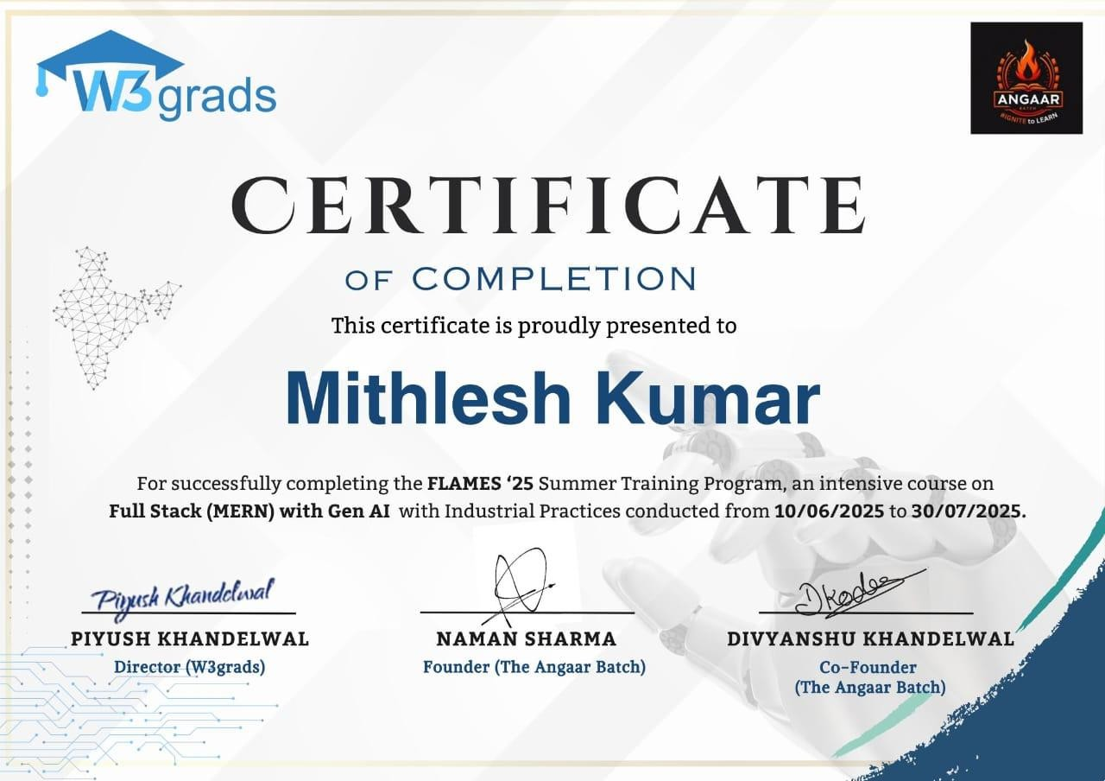
Certification
Certificate ID: FLAMES25MERN2052

Slide 3
Table of Contents
S.No | Title | Page.no
1. | Student Declaration | 4
2. | Acknowledgement | 5
3. | Abstract | 6
4. | Internship Learning details | 7
5. | Project Work | 8
6. | Screenshots | 9-13
7. | Skills Gained | 13
8. | Challenges and Solutions | 14
9. | Conclusions | 14

Slide 4
Student Declaration
To whom so ever it may concern
I, Mithlesh Kumar, Redg Num- 12304831, hereby declare that the work done by me on “Full Stack (MERN) with Gen AI” from 10 June, 2025 to 30 July, 2025, is a record of original work for the partial fulfilment of the requirements for the award of the degree, B.Tech
(Computer Science and Engineering).
Name of the Student: Mithlesh Kumar Registration no: 12325796
Dated: August 10, 2025

Slide 5
Acknowledgement
I would like to express my sincere gratitude for providing me with the opportunity to undergo my Summer Internship on Full Stack (MERN) with Gen AI , The structured training, practical sessions, and expert guidance offered during this 1.5-month program have been immensely valuable in enhancing my technical skills and understanding of full stack development. This training program has equipped me with essential skills that I applied directly in my project work, making the entire experience both enriching and transformative. Special thanks go to Mr. Piyush Khandelwal( Founder of W3grads), Mr.Naman Sharma(Founder of Angaar batch), Mr.Divyanshu Khandelwal(co-founder of Anga ar batch) I am deeply thankful to my mentors and trainers at W3Grades for their continuous support, timely feedback, and encouragement throughout the internship. Their in-depth knowledge and industry-oriented teaching methods have helped me gain hands-on experience with technologies like HTML, CSS, JavaScript, React.js, Node.js, Express.js, and MongoDB.
Additionally, I am deeply thankful to the faculty members at Lovely Professional University, especially those in the Computer Science and Engineering department, for their unwavering encouragement and mentorship. Their advice on project selection and execution helped me align my internship goals with academic requirements, ensuring a seamless integration of learning outcomes. The constructive feedback from my university mentors during progress reviews was instrumental in refining my approach to problem-solving and code development. Furthermore, I extend my appreciation to the online learning platform and resources offered by W3grads, which facilitated interactive sessions, problem-solving exercises, and collaborative tools that made the virtual training engaging and effective. Without these resources, navigating the challenges of competitive programming and simulator development would have been far more daunting. Finally, I am profoundly grateful to my family and friends for their constant support, patience, and motivation during this intensive period. Their encouragement during late-night coding sessions and moments of frustration kept me focused and determined, reminding me of the importance of perseverance in achieving professional milestones. This collective support has made the completion of this internship and the associated report a truly rewarding accomplishment.
Mithlesh Kumar

Slide 6
Abstract
This report presents an overview of my Summer Internship of 1 month and 20 days undertaken at W3Grades, focusing on Full Stack Development using the MERN stack along with an introduction to Generative AI. The primary objective of this internship was to enhance my knowledge and practical skills in modern web development technologies, including HTML, CSS, JavaScript, React.js, Node.js, Express.js, and MongoDB, Gen AI while also exploring emerging AI-powered applications.
During the internship, I worked on a capstone project titled StorySprout, an interactive story generator website ,which is a group project of 5 team members and every member got chance to lead the the team and enhance their professional leadership skills. The platform utilizes the MERN stack for seamless frontend–backend integration and incorporates generative AI concepts to create engaging, dynamic narratives for users. This project strengthened my skills in UI/UX design, API integration, database management, and problem-solving.
The training combined theoretical concepts with hands-on implementation, enabling me to understand the complete software development life cycle. Everyday, scrum meeting was conducted by mentor for proper understanding the work flow on the project. It also improved my ability to work independently, manage deadlines, and adapt to new technologies quickly. Overall, the internship was an enriching experience that not only enhanced my technical expertise but also provided valuable insight into real-world web application development.

Slide 7
Internship Learning details (weekly basis)
Week 1: Introduction & Frontend Basics
Orientations, HTML5, CSS3
Responsive design using Tailwind/Bootstrap
Git and Github
Week 2: Fundamental of Javascript
Learned JavaScript fundamentals including variables, functions, loops, and ES6 features.
Gained skills in DOM manipulation, event handling, and form validation.
Worked with asynchronous programming, API fetching, and error handling.
Week 3: React.js Development
Components, Props, State, Hooks, React Routing
Week 4: Backend with Node.js & Express
REST API development
Handling requests, routes, and middleware
Week 5-6: MongoDB Integration
CRUD operations
Mongoose schema
Week 6-7: Full Stack Project
Combining frontend and backend
Authentication (JWT/Google Login)
Deployment

Slide 8
Project Work
Title : StorySprout (AI based story generator websites)
What It Is:
A tool where users — especially kids or parents — can input a few ideas (like “a lion, a moon, and a treasure hunt”) and get a full children’s story written for them instantly.
How It Works:
User enters basic inputs: characters, setting, and maybe age group.
AI creates a full story. • App formats it into storybook style (pages, font, illustrations using AI-generated images).
Purpose:
Helps children explore creativity and improves reading habits, while also being a fun tool for parents and teachers.
Technology Used:
HTML,
CSS,
JavaScript,
React.js,
Node.js,
Express.js
MongoDB
Backend part
Gen A

Slide 9
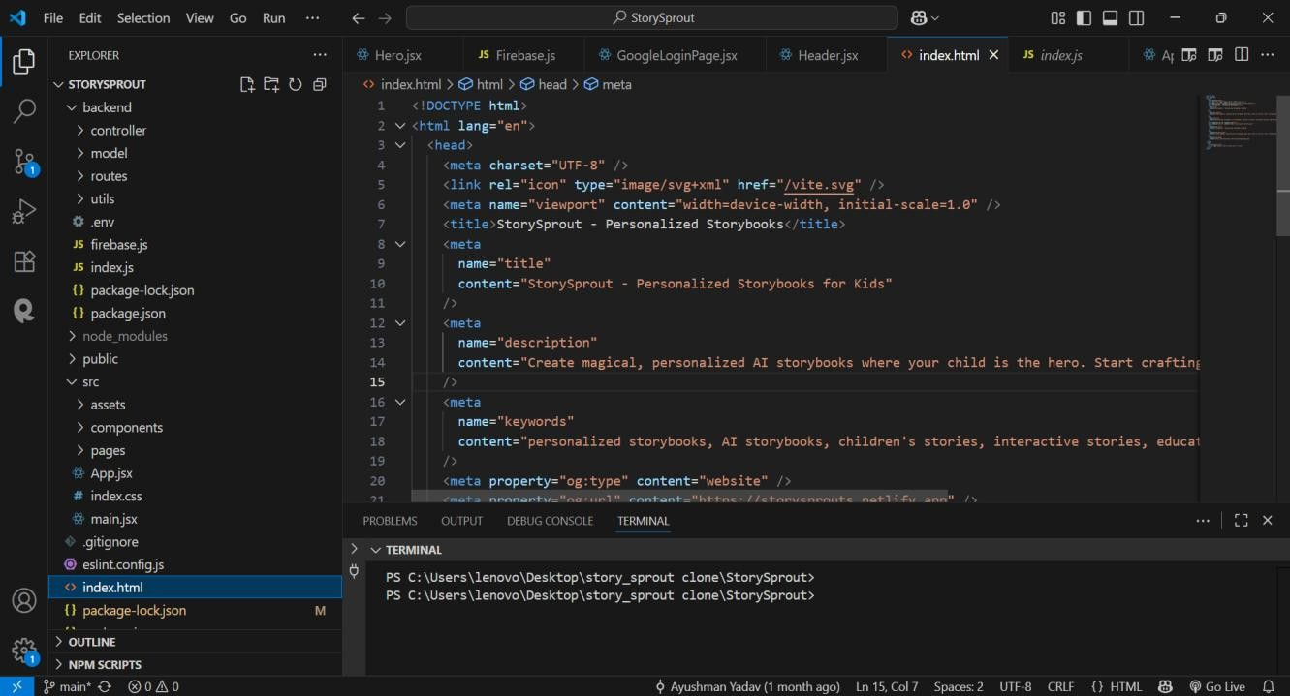
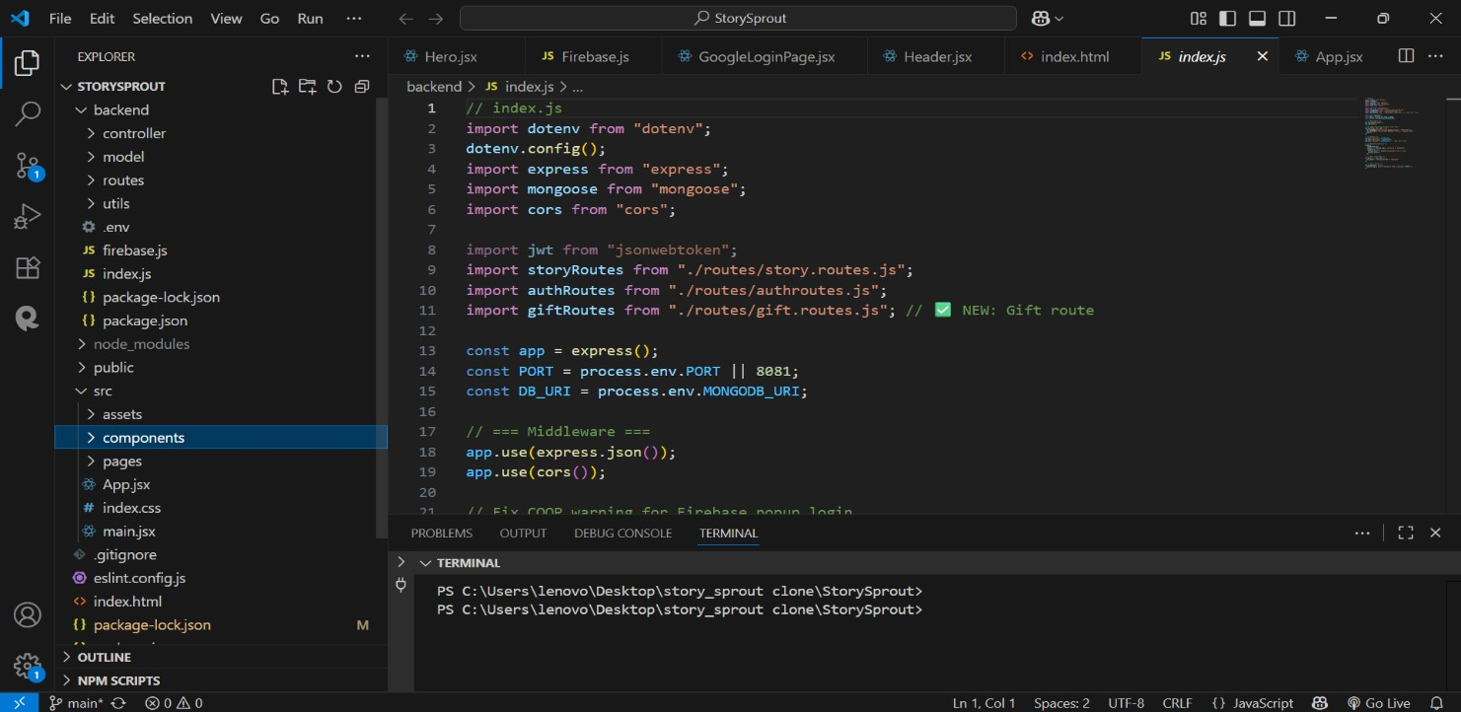
Screenshots of Codes :
Index.html(main page, as it is SPA -single page application )
Components of websites

Slide 10
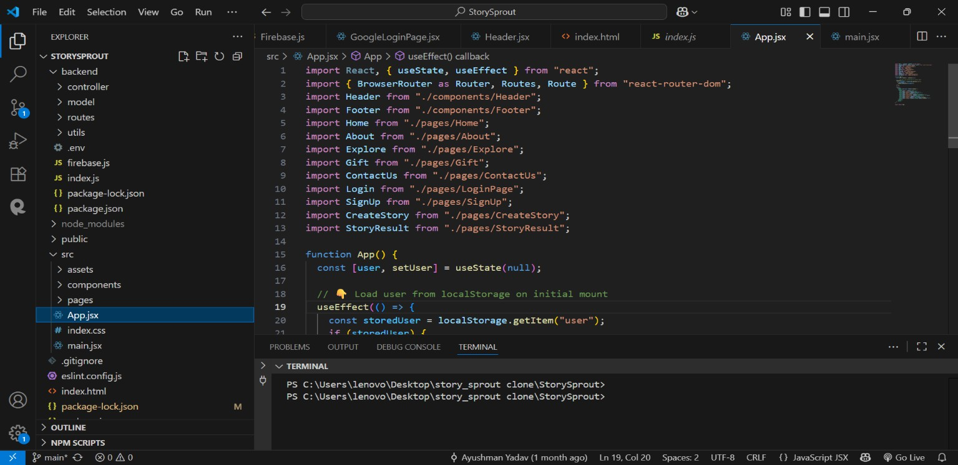
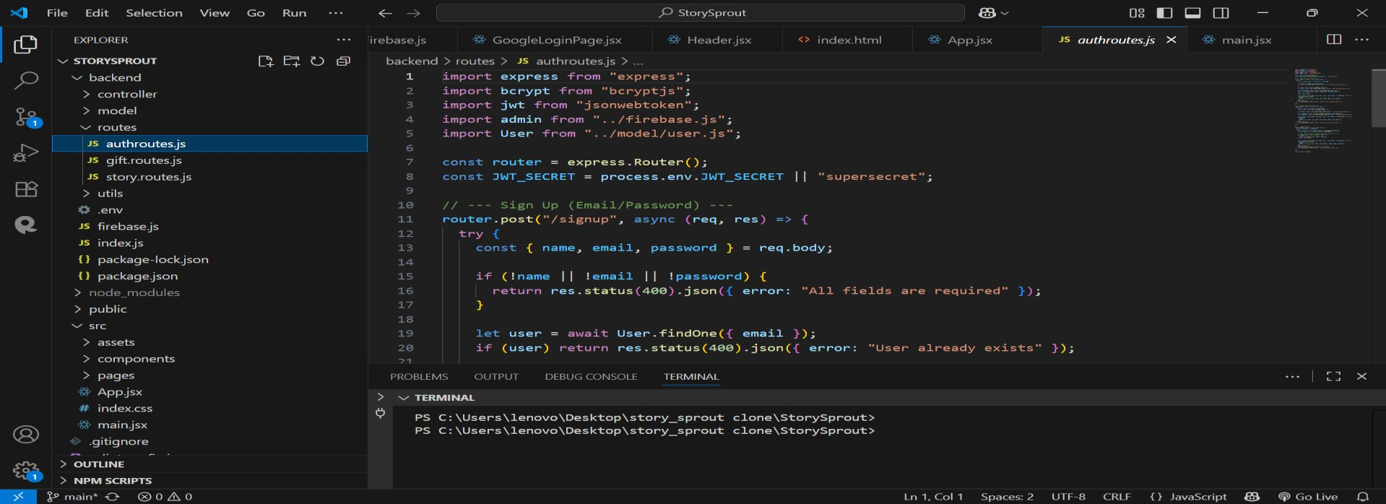
Routing part
Backend part
10

Slide 11
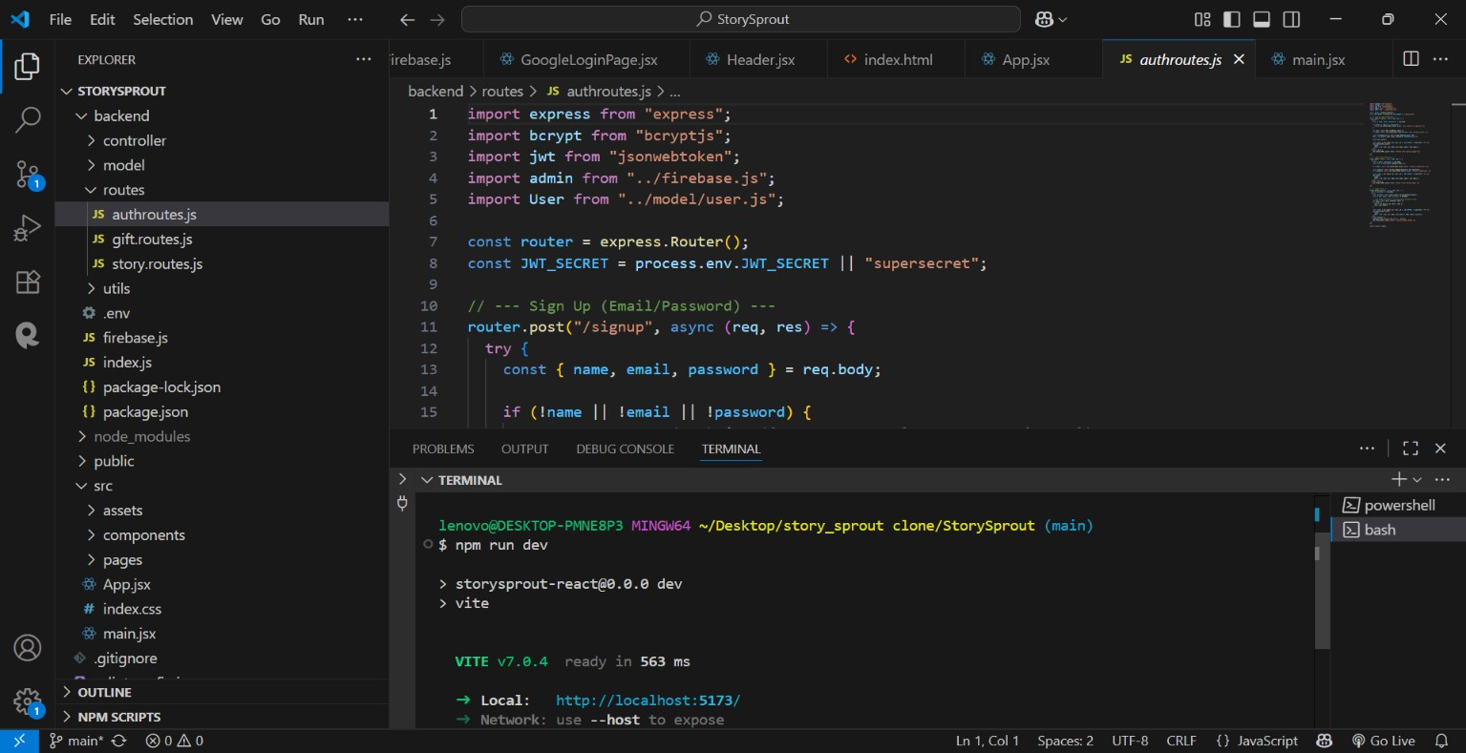
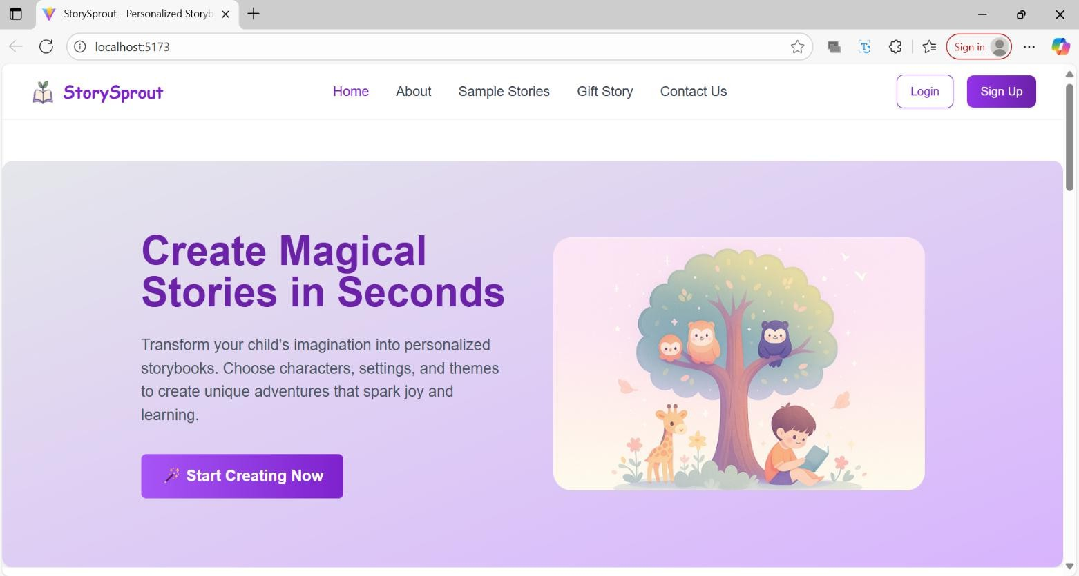
u can see in terminal ,it runs in local host
Home Page of Storysprout website

Slide 12
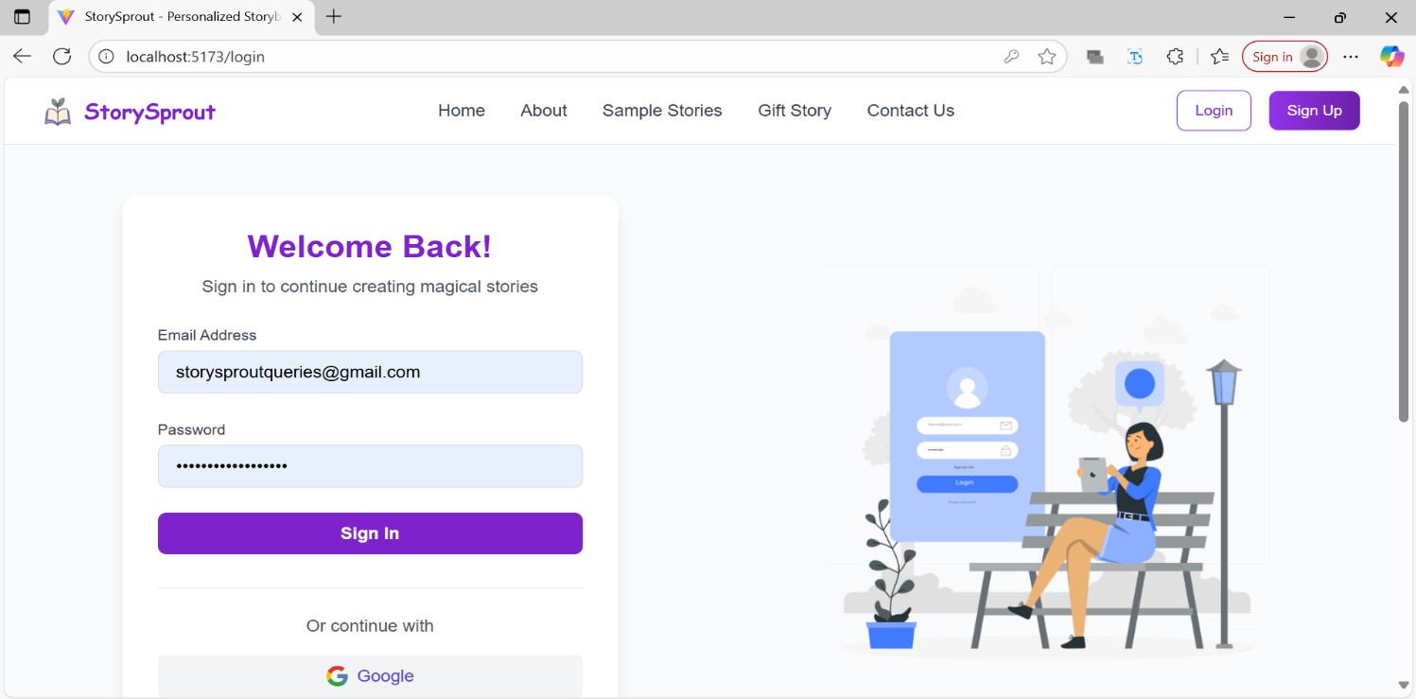
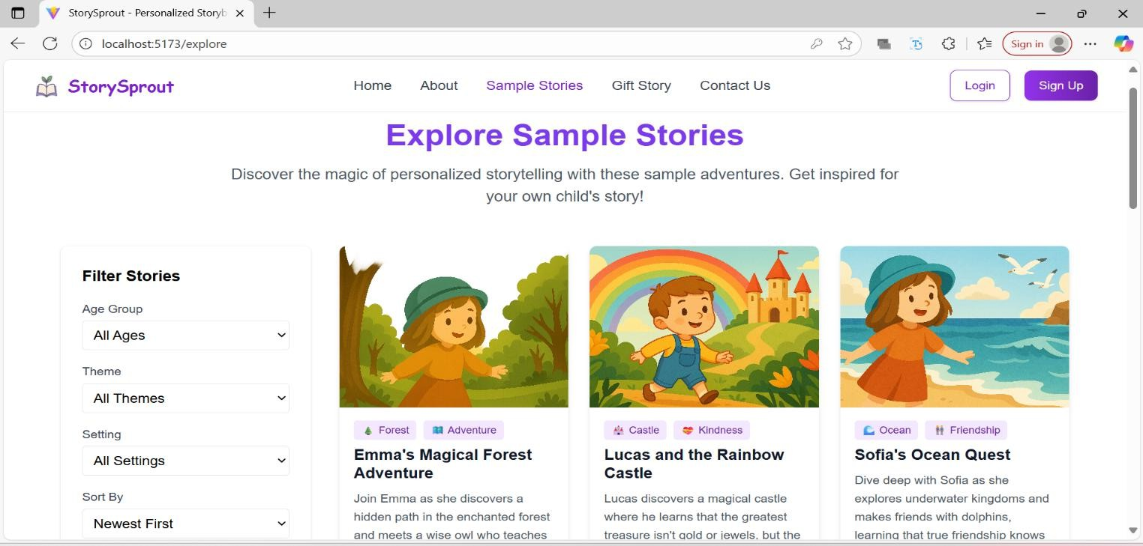
Login page
Few Sample Stories Page

Slide 13
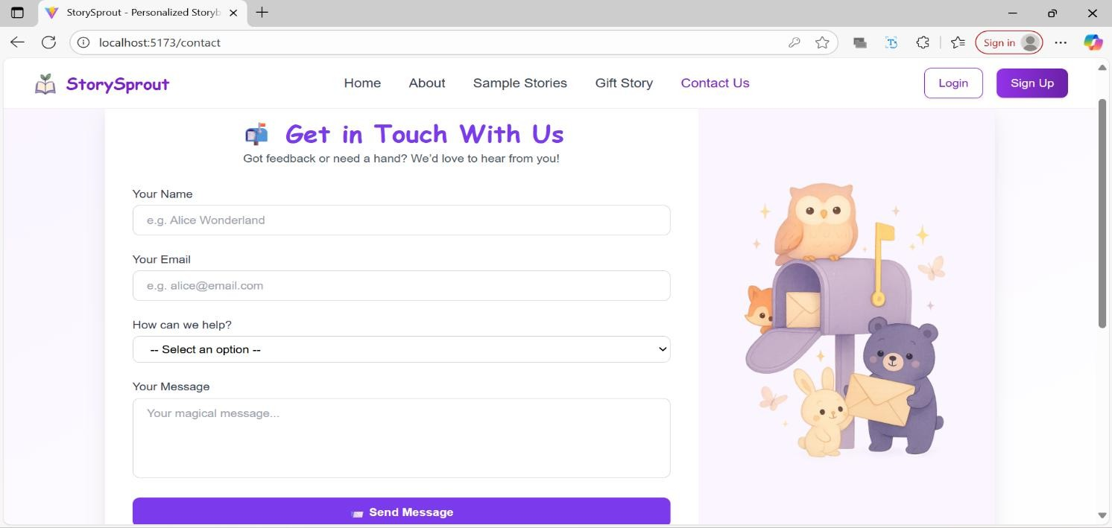
Contact page
Skills Gained:
Technical Skills (HTML,CSS, Javascript ,React, Node, MongoDB, API handling, Git, Backend )
Soft Skills (time management, teamwork , problem-solving)

Slide 14
Challenges & Solutions
Mention difficulties (debugging, connecting frontend-backend, learning curve)
Solved by keeping scrum meetings daily as we worked in group of 4
members
Conclusions
The 1 month and 20 days summer internship at W3Grades was a highly enriching experience that significantly enhanced my technical and problem- solving skills. I gained practical knowledge of full stack development using the MERN stack, explored Generative AI concepts, and successfully developed a functional project, StorySprout. This journey not only strengthened my understanding of web technologies but also improved my ability to work on real-world applications from design to deployment.
The skills and experience acquired during this internship will serve as a strong foundation for my career in software development. By mastering modern tools and frameworks, I am now better equipped to contribute to innovative projects, adapt to emerging technologies, and pursue opportunities in both full stack and AI-driven application development.

